Slide 1



MENDELEY
MENDELEY
https://www.mendeley.com/
By Students:
- Naif Alqubalee
- Ahmed Jaroon
- Mahfoud Alajm
- Basel Dahoul
- Omer Bo Omer

Slide 2
Overview
Introduction
Advantages
Comparison
Paid & Free versions
Explain How to use
Q & A
01
02
03
04
05
06

Slide 3
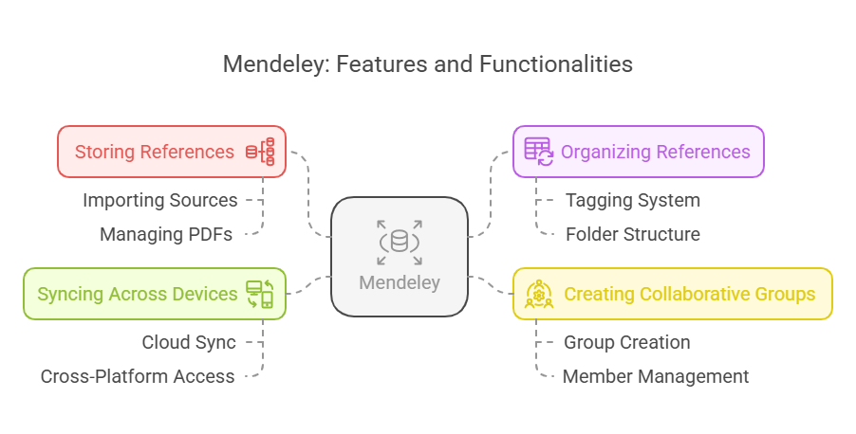
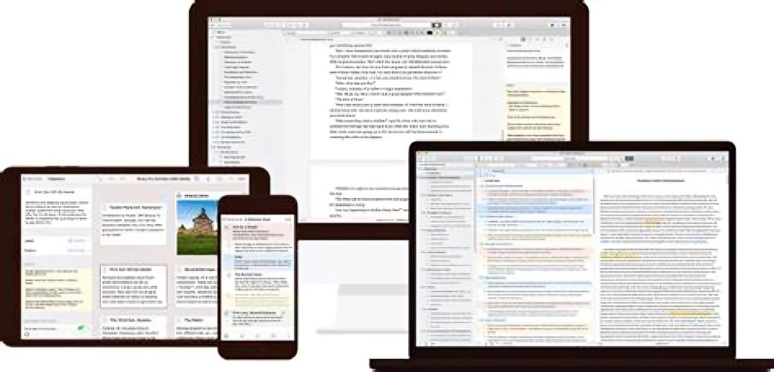

Introduction
Mendeley is a powerful and integrated reference management software that helps researchers and students organize their research efficiently by arranging and properly documenting sources.

Slide 4

MENDELEY ADVANTAGE
1-Citation Style Selection: You can choose the citation style, such as Vancouver, AMA, APA, and Chicago, helping you adhere to the required academic standards.
2- Automatic Reference Organization: The program automatically organizes references according to the order of the paragraphs, making it easier to manage sources.
3- Reference Sharing: You can easily share references with your fellow researchers, facilitating collaboration on research projects.
4-Access to Related Research: The application allows you to view research related to your topic, helping you expand your knowledge.

Slide 5
MENDELEY ADVANTAGE
5 - Importing Research from Other Software: You can import research from any other research software, making it easy to gather information.
6 -Transferring Research to Mendeley: You can easily transfer research to the Mendeley program, consolidating all your research sources in one place.
7- Access from Any Device: You can access your personal library from any other device using your password, allowing you to reach your information at any time.
8- Integration with Microsoft Word: You can use Mendeley within Microsoft Word to facilitate citation writing, making the writing process smoother.
Welcome Message !

Slide 6
Comparison
Mendeley Vs Zotero
Mendeley
Zotero
Simple and beginner-friendly interface.
Supports importing references from databases and offers 2GB of cloud storage.
Integrates with Word and LibreOffice.
Offers internal search for academic papers.
2GB free storage, with paid options available.
Customizable interface, may be slightly more complex.
Collects references directly from the web and provides 300MB of cloud storage.
Integrates with Word, Google Docs, and LibreOffice.
Focuses on reference collection without internal search features.
300MB free storage, with affordable storage upgrade options.
Provision Company

Slide 7

Paid Vs Free
PRESENTATION
Paid
Free
Enhanced Storage Options:
• Upgraded plans with additional storage:
Plus Plan: 5 GB at $4.99/month or $55/year (one month free)
Pro Plan: 10 GB at $9.99/month or $110/year (one month free)
Max Plan: Unlimited personal storage (starting at 100 GB) at $14.99/month or $165/year (one month free)
Advanced Group Collaboration:
• Increased group storage (up to 100 GB) • Expanded private group capabilities:
Up to 1,000 groups
Each private group can host up to 100 members
Storage & File Management:
• 2 GB of personal online storage for PDFs and document attachments • Up to 100 MB shared storage across all groups • Cloud-based syncing to access your library on multiple devices
Group Collaboration:
• Create and own up to 5 private groups • Each private group is limited to 25 members
MENDELEY

Slide 8
USE

Slide 9

Q & A

